Slide 1
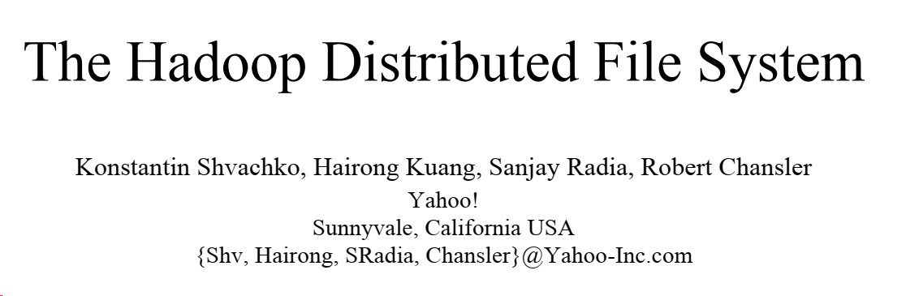
Presented by P. Krishna Reddy

Slide 2
Outline
Introduction and Related Work
Architecture
File I/O operations and replica management

Slide 3
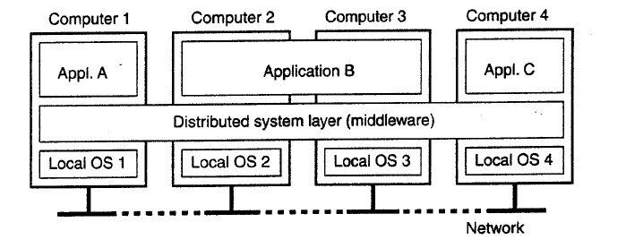
Distributed System (DS)
A distributed system is a collection of independent computers that appears to its users as a single coherent system (Single System Image) - Loosely coupled systems
Computing power and storage are shared among the users.

Slide 4
Advantages of Distributed System
Scalability
Reliability
Availability
Communication

Slide 5
Cluster Systems
Collection of similar computers (nodes) connected by high speed LAN
Master node, Computational nodes
Nodes run similar OS
Master node controls storage allocation and job scheduling
Provides single system image
Computing power and storage are shared among the users.

Slide 6
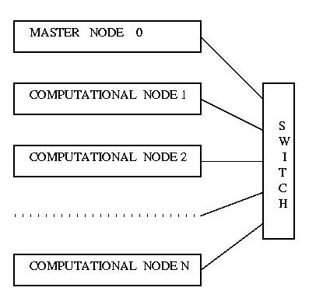
Cluster Computing .. Contd

Slide 7
Distribute File System (DFS)
File system that manages the storage across a network of machines is called distributed file system.
A DFS is a client / server-based application that allows clients to access and process data stored on the server(s) as if it were on their own computer.

Slide 8
Distributed File System
Name Server – Global directory - Meta data of files are stored
Data Servers
Data files (objects) are stored
User programs are executed

Slide 9
Hadoop
Google published a paper – Google File System – 2003, Mapreduce – 2004
In 2005, NDFS (NutchDFS) and Mapreduce were created (based on GFS and Mapreduce) by Doug cutting.
Later in 2006, it was renamed as Hadoop by Yahoo!
In 2008, it became an open source technology and came under Apache.
HDFS is the file system component of Hadoop.

Slide 10
Hadoop Project Components
Adoop HDFS: Distributed File System
Apache HBase, a table-oriented database built on top of Hadoop.
Apache Hive, a data warehouse built on top of Hadoop that makes data accessible through an SQL-like language.
Apache Sqoop, a tool for transferring data between Hadoop and other data stores.
Apache Pig, a platform for creating programs that run on Hadoop in parallel. Pig Latin is the language used here.
ZooKeeper, a tool for configuring and synchronizing Hadoop clusters.

Slide 11
Outline
Introduction and Related Work
Architecture
File I/O operations and replica management

Slide 12
Hadoop Distributed File System (HDFS)
HDFS is open‐source DFS developed under Apache
Designed to store very large datasets reliably.
Master-Slave Architecture
Single Name node acts as the master
Multiple Data nodes act as workers (slaves)
64 MB block size (can be increased)
Reduces seek time
Data is transferred as per disk transfer rate (100 MB/s)
The interface to HDFS is patterned after the UNIX file system
HDFS stores file system metadata and application data separately.
HDFS stores metadata on a dedicated server, called the NameNode.
Application data are stored on other servers called DataNodes. All servers are fully connected and communicate with each other using TCP-based protocols.

Slide 13
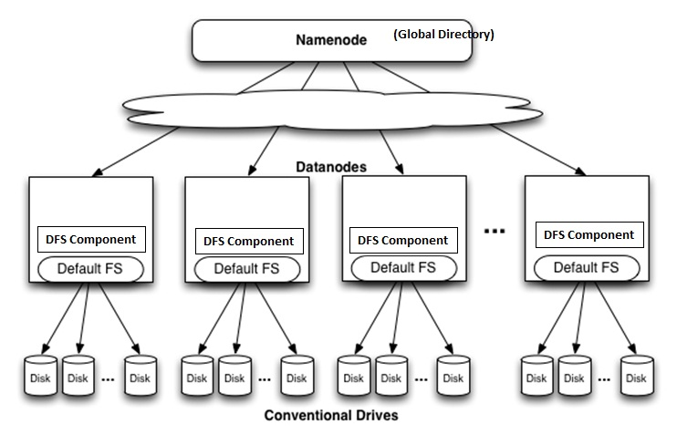
HDFS - Architecture

Slide 14
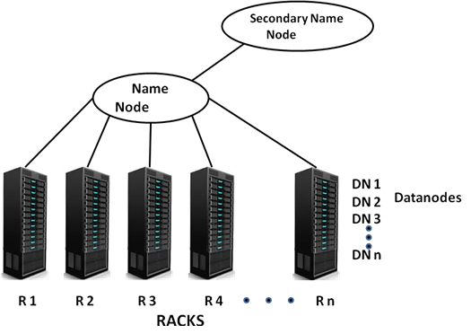
Rack organization in Hadoop

Slide 15
Name Node
The HDFS namespace is a hierarchy of files and directories.
Files and directories are represented on the NameNode by inodes, which record attributes like permissions, modification and access times, namespace and disk space quotas.
The file content is split into large blocks (typically 128 megabytes, but user selectable file-by-file) and each block of the file is independently replicated at multiple DataNodes (typically three, but user selectable file-by-file).
The NameNode maintains the namespace tree and the mapping of file blocks to DataNodes (the physical location of file data).

Slide 16
Name Node
An HDFS client wanting to read a file first contacts the NameNode for the locations of data blocks comprising the file and then reads block contents from the DataNode closest to the client.
When writing data, the client requests the NameNode to nominate a suite of three DataNodes to host the block replicas.
The client then writes data to the DataNodes in a pipeline fashion.
The current design has a single NameNode for each cluster.
The cluster can have thousands of DataNodes and tens of thousands of HDFS clients per cluster, as each DataNode may execute multiple application tasks concurrently.

Slide 17
Name node (…)
HDFS keeps the entire namespace in RAM.
The inode data and the list of blocks belonging to each file comprise the metadata of the name system called the image.
The persistent record of the image stored in the local host’s native files system is called a checkpoint.
The NameNode also stores the modification log of the image called the journal in the local host’s native file system.
For improved durability, redundant copies of the checkpoint and journal can be made at other servers.
During restarts the NameNode restores the namespace by reading the namespace and replaying the journal.
The locations of block replicas may change over time and are not part of the persistent checkpoint.

Slide 18
Data Nodes
Each block replica on a DataNode is represented by two files in the local host’s native file system.
The first file contains the data itself and the second file is block’s metadata including checksums for the block data and the block’s generation stamp.
During startup each DataNode connects to the NameNode and performs a handshake.
The purpose of the handshake is to verify the namespace ID and the software version of the DataNode. If either does not match that of the NameNode the DataNode automatically shuts down.
The namespace ID is assigned to the file system instance when it is formatted.
A DataNode that is newly initialized and without any namespace ID is permitted to join the cluster and receive the cluster’s namespace ID

Slide 19
Data Nodes (…)
A DataNode sends a block report about replicas
A block report contains the block id, the generation stamp and the length for each block replica the server hosts.
Block reports are sent every hour
During normal operation DataNodes send heartbeats to the NameNode to confirm that the DataNode is available
Heartbeat contains several types of information
The default heartbeat interval is three seconds.
If the NameNode does not receive a heartbeat from a DataNode in ten minutes the NameNode considers the DataNode to be out of service and the block replicas hosted by that DataNode to be unavailable.
The NameNode then schedules creation of new replicas

Slide 20
Data Nodes (…)
The NameNode does not directly call DataNodes.
It uses replies to heartbeats to send instructions to the DataNodes. The instructions include commands to:
replicate blocks to other nodes
remove local block replicas;
re-register or to shut down the node;
send an immediate block report.
Integrity is managed with the above method.

Slide 21
HDFS Client
User applications access the file system using the HDFS client, a code library that exports the HDFS file system interface
Similar to most conventional file systems, HDFS supports operations to read, write and delete files, and operations to create and delete directories.
The user references files and directories by paths in the namespace. The user application generally does not need to know that file system metadata and storage are on different servers, or that blocks have multiple replicas.

Slide 22
Reading from a File
HDFS client sends the read request to Name Node
Name Node returns the addresses of a set of Data Nodes containing replicas for the requested file
First block of the file can be read by calling read function and by giving address of the closest Data Node.
The same process is repeated for all blocks of the requested file

Slide 23
Writing to a File
Default replication factor is 3 for HDFS. Applications can reset the replication factor.
Write function is used for writing into a file. Assume that ‘n’ blocks have to be written.

Slide 24
Writing to a File
(First) Block is written into the local data node.
Name node is contacted to get a list of suitable data nodes (G) to store replicas of the (first) block. Then the first block is copied into one data node from G and then that block is forwarded to another data node specified in G.
This process is repeated for the remaining set of blocks (n-1) of the file.

Slide 25
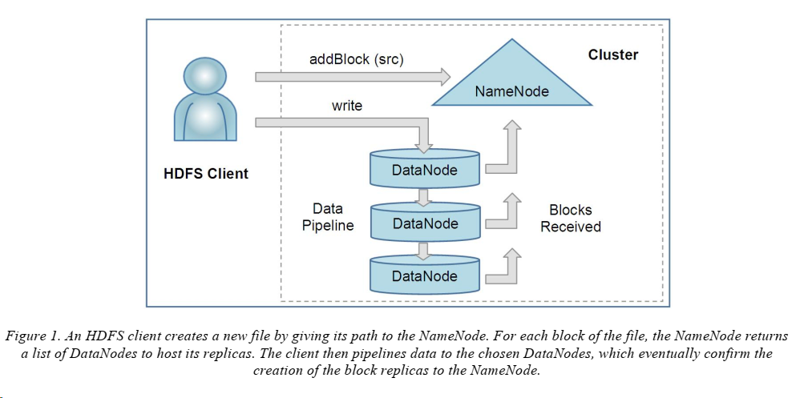

Slide 26
HDFS Client
Unlike conventional file systems, HDFS provides an API that exposes the locations of a file blocks.
This allows applications like the MapReduce framework to schedule a task to where the data are located, thus improving the read performance.
It also allows an application to set the replication factor of a file.
By default a file’s replication factor is three. For critical files or files which are accessed very often, having a higher replication factor improves their tolerance against faults and increase their read bandwidth.

Slide 27
Image and Journal
The namespace image is the file system metadata that describes the organization of application data as directories and files.
A persistent record of the image written to disk is called a checkpoint.
The journal is a write-ahead commit log for changes to the file system that must be persistent.
For each client-initiated transaction, the change is recorded in the journal, and the journal file is flushed and synched before the change is committed to the HDFS client.
During startup the NameNode initializes the namespace image from the checkpoint, and then replays changes from the journal until the image is up-to-date with the last state of the file system.
A new checkpoint and empty journal are written back to the storage directories before the NameNode starts serving clients

Slide 28
Image and Journal
If either the checkpoint or the journal is missing, or becomes corrupt, the namespace information will be lost partly or entirely.
In order to preserve this critical information HDFS can be configured to store the checkpoint and journal in multiple storage directories.
Recommended practice is to place the directories on different volumes, and for one storage directory to be on a remote NFS server.

Slide 29
CheckpointNode
The NameNode in HDFS, in addition to its primary role serving client requests, can alternatively execute either of two other roles, either a CheckpointNode or a BackupNode. The role is specified at the node startup.
The CheckpointNode periodically combines the existing checkpoint and journal to create a new checkpoint and an empty journal.
Runs at a different node
Creating periodic checkpoints is one way to protect the file system metadata.
Creating a checkpoint lets the NameNode truncate the tail of the journal when the new checkpoint is uploaded to the NameNode.

Slide 30
BackupNode
The BackupNode is capable of creating periodic checkpoints, but in addition it maintains an inmemory, up-to-date image of the file system namespace that is always synchronized with the state of the NameNode

Slide 31
Outline
Introduction and Related Work
Architecture
File I/O operations and replica management

Slide 32
File Read and Write
An application adds data to HDFS by creating a new file and writing the data to it. After the file is closed, the bytes written cannot be altered or removed except that new data can be added to the file by reopening the file for append.
HDFS implements a single-writer, multiple-reader model.
The HDFS client that opens a file for writing is granted a lease for the file; no other client can write to the file.
The writing client periodically renews the lease by sending a heartbeat to the NameNode.
When the file is closed, the lease is revoked.
Lease can be extended using lease management protocol

Slide 33
File read and write
An HDFS file consists of blocks. When there is a need for a new block, the NameNode allocates a block with a unique block ID and determines a list of DataNodes to host replicas of the block.
The DataNodes form a pipeline, the order of which minimizes the total network distance from the client to the last DataNode.
Bytes are pushed to the pipeline as a sequence of packets.
The bytes that an application writes first buffer at the client side.
After a packet buffer is filled (typically 64 KB), the data are pushed to the pipeline.
The next packet can be pushed to the pipeline before receiving the acknowledgement for the previous packets.
After data are written to an HDFS file, HDFS does not provide any guarantee that data are visible to a new reader until the file is closed.
If a user application needs the visibility guarantee, it can explicitly call the hflush operation.

Slide 34
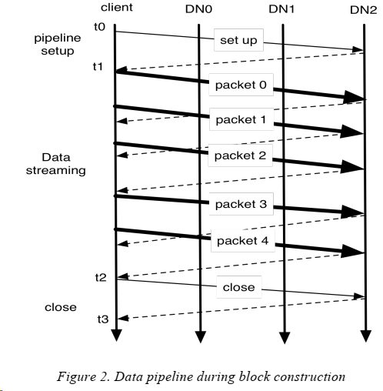

Slide 35
File Read
When a client opens a file to read, it fetches the list of blocks and the locations of each block replica from the NameNode.
The locations of each block are ordered by their distance from the reader.
When reading the content of a block, the client tries the closest replica first. If the read attempt fails, the client tries the next replica in sequence.
A read may fail if the target DataNode is unavailable, the node no longer hosts a replica of the block, or the replica is found to be corrupt when checksums are tested.
The design of HDFS I/O is particularly optimized for batch processing systems, like MapReduce, which require high throughput for sequential reads and writes.

Slide 36
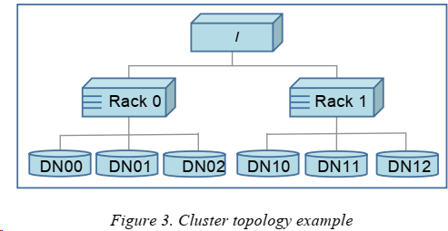
Block Placement
Nodes are spread across multiple racks instead of flat topology
Nodes of a rack share a switch, and rack switches are connected by one or more core switches. Communication between two nodes in different racks has to go through multiple switches.
The default HDFS block placement policy provides a tradeoff between minimizing the write cost, and maximizing data reliability, availability and aggregate read bandwidth
In most cases, network bandwidth between nodes in the same rack is greater than network bandwidth between nodes in different racks.

Slide 37
Replication Management
The NameNode endeavors to ensure that each block always has the intended number of replicas.
The NameNode detects that a block has become under- or over-replicated when a block report from a DataNode arrives.
When a block becomes over replicated, the NameNode chooses a replica to remove.
The goal is to balance storage utilization across DataNodes without reducing the block’s availability
The NameNode also makes sure that not all replicas of a block are located on one rack.

Slide 38
Balancer
The balancer is a tool that balances disk space usage on an HDFS cluster.
It iteratively moves replicas from DataNodes with higher utilization to DataNodes with lower utilization.
One key requirement for the balancer is to maintain data availability.
When choosing a replica to move and deciding its destination, the balancer guarantees that the decision does not reduce either the number of replicas or the number of racks.

Slide 39
Block Scanner
Each DataNode runs a block scanner that periodically scans its block replicas and verifies that stored checksums match the block data.
Whenever a read client or a block scanner detects a corrupt block, it notifies the NameNode.
The NameNode marks the replica as corrupt, but does not schedule deletion of the replica immediately. Instead, it starts to replicate a good copy of the block.
This policy aims to preserve data as long as possible. So even if all replicas of a block are corrupt, the policy allows the user to retrieve its data from the corrupt replicas.

Slide 40
Decommissioing
The cluster administrator specifies which nodes can join the cluster by listing the host addresses of nodes that are permitted to register and the host addresses of nodes that are not permitted to register.
A present member of the cluster that becomes excluded is marked for decommissioning.
Once a DataNode is marked as decommissioning, it will not be selected as the target of replica placement, but it will continue to serve read requests.
The NameNode starts to schedule replication of its blocks to other DataNodes. Once the NameNode detects that all blocks on the decommissioning DataNode are replicated, the node enters the decommissioned state.
Then it can be safely removed from the cluster without jeopardizing any data availability.

Slide 41
Inter-Cluster Data Copy
HDFS provides a tool called DistCp for large inter/intra-cluster parallel copying. It is a MapReduce job; each of the map tasks copies a portion of the source data into the destination file system.
The MapReduce framework automatically handles parallel task scheduling, error detection and recovery.

Slide 42
Summary
Introduction and Related Work
Architecture
File I/O operations and replica management

Slide 43
THANK YOU

